Slide 1
FLOW MEASUREMENTS
Unit 4

Slide 2
Flow Meters
Mechanical type flow meters. Fixed restriction variable head type flow meters using different sensors like orifice plate, venturi tube, flow nozzle, pitot tube, dall tube, quantity meters like positive displacement meters, mass flow meters etc. fall under mechanical type flow meters.
Inferential type flow meters. Variable area flow meters (Rotameters), turbine flow meter, target flow meters etc.
Electrical type flow meters. Electromagnetic flow meter, Ultrasonic flow meter, Laser Doppler, Anemometers etc are fall under electrical type flow meters.

Slide 3
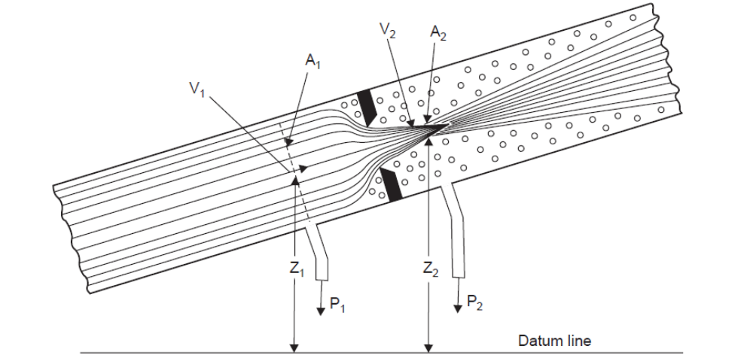
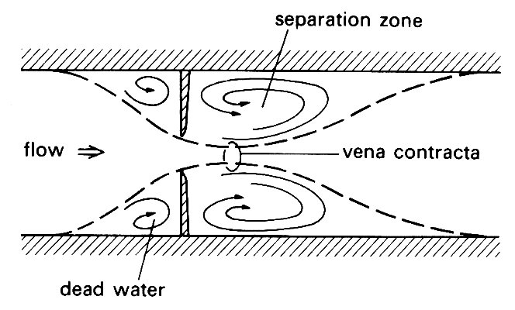

Bernoulli’s equation for an incompressible

Slide 4
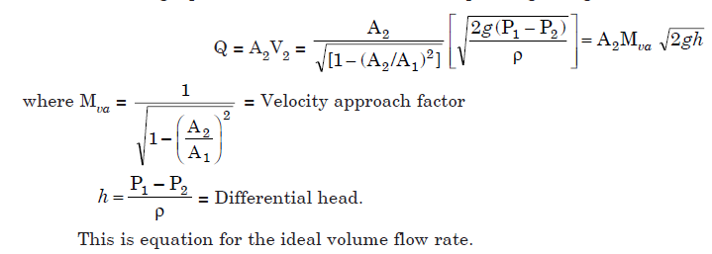
Flow Equation
Q = volume flow rate in m3/sec

Slide 5
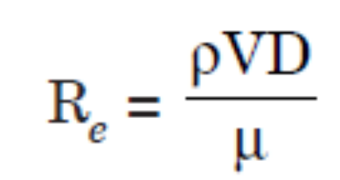
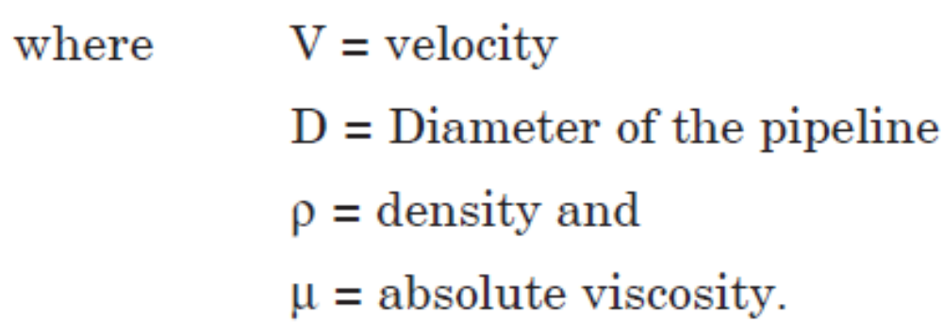
Reynolds Number

Slide 6
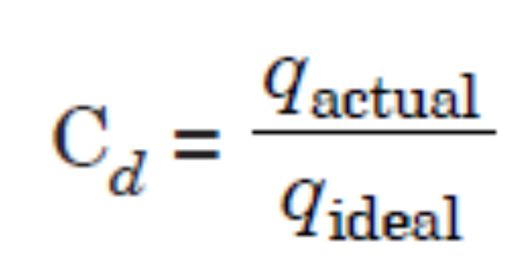
Discharge Coefficient (Cd)
Discharge coefficient, C is defined as the ratio between actual volumetric flow rate and ideal volumetric flow rate.

Slide 7
β Ratio
the Beta ratio is the ratio between the diameter of the restriction and the inside diameter of the pipe.
β= d/D
where d = diameter of the restriction
D = inside diameter of the pipe.

Slide 8
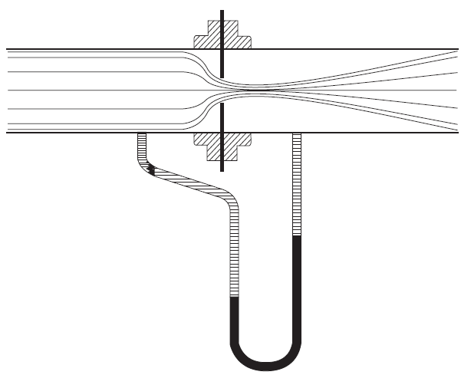

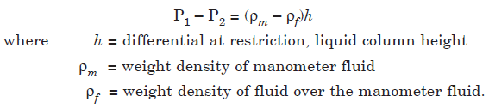
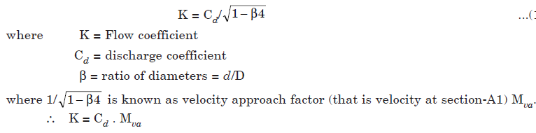
Actual flow rate

Slide 9
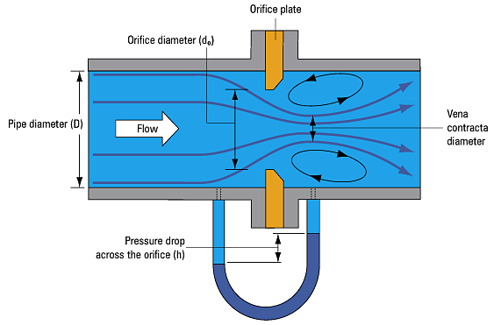
Orifice Flow Meter

Slide 10
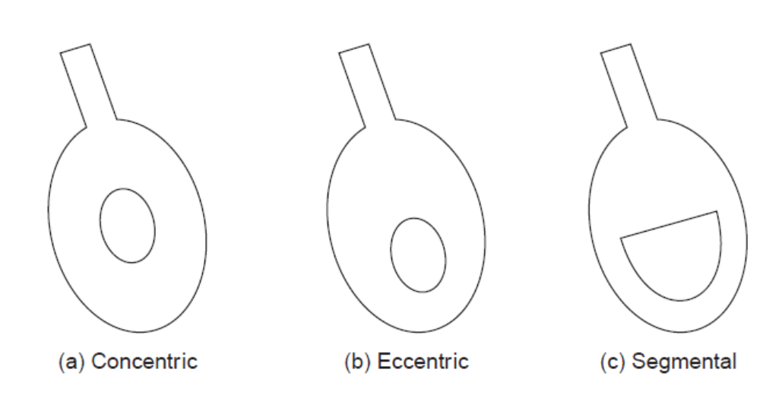
Orifice Plates

Slide 11
The flow pattern shows an effective decrease in cross section beyond the orifice plate, with a maximum velocity and minimum pressure at the venacontracta.
The material chosen for orifice plate is of any rigid material of non-rusting and non-corrodible.
The common materials used are Stainless steel, Monel, Phosphor bronze, Glass, Ceramics, Plastics, Brass, Copper, Aluminium and Tantalum.

Slide 12
There are five common locations for the differential pressure taps :
  (i) Flange taps
  (ii) Venacontracta taps
  (iii) Radius taps
  (iv) Full flow or pipe taps and
  (v) Corner taps.

Slide 13
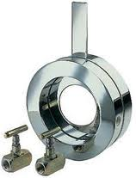

Slide 14
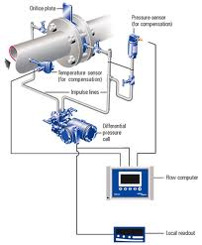

Slide 15
Orifice…
Advantages
  Less cost, characteristics are predictable, require less space and suitable for less diameter pipes also
Disadvantages
  Pressure recovery is poor, Coefficient Discharge is less, inaccuracy due to corrosion and sealing and not suitable for slurries

Slide 16
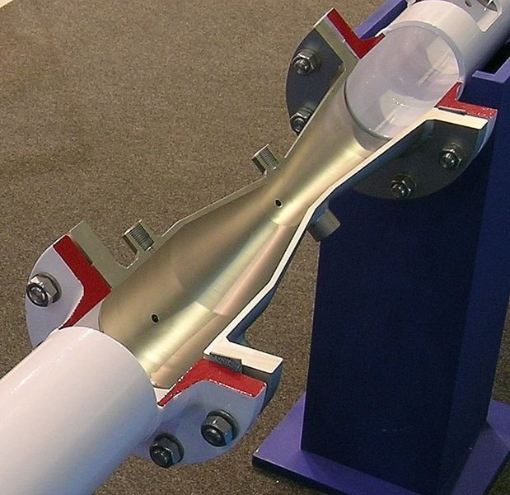
Venturi flow meter

Slide 17
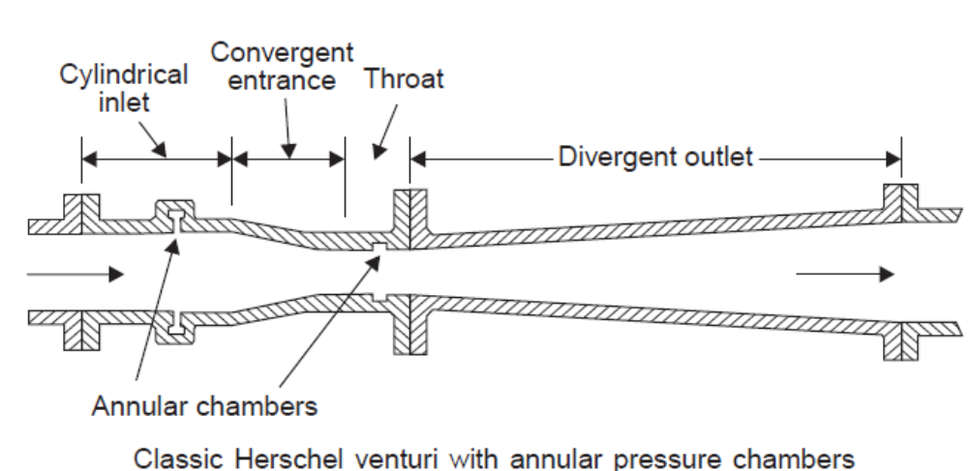

Slide 18
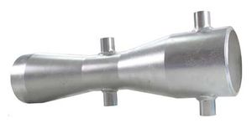

Slide 19
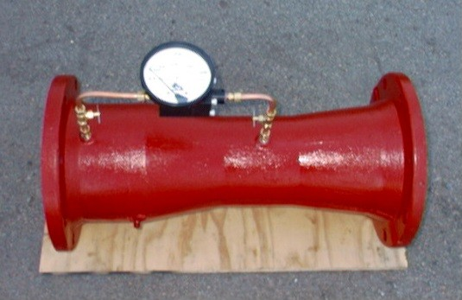

Slide 20
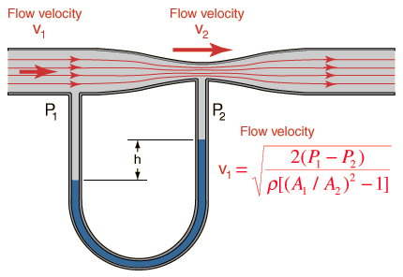

Slide 21
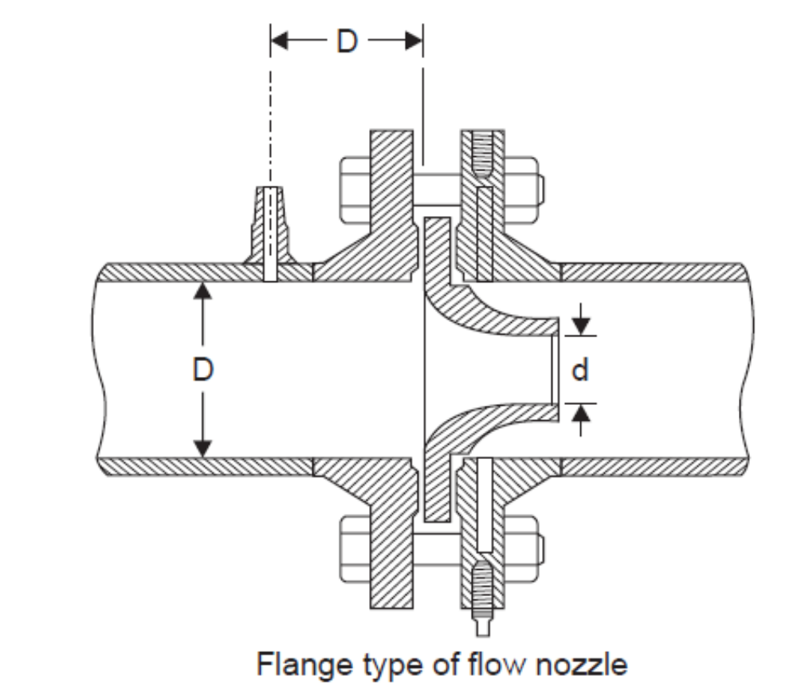

Slide 22
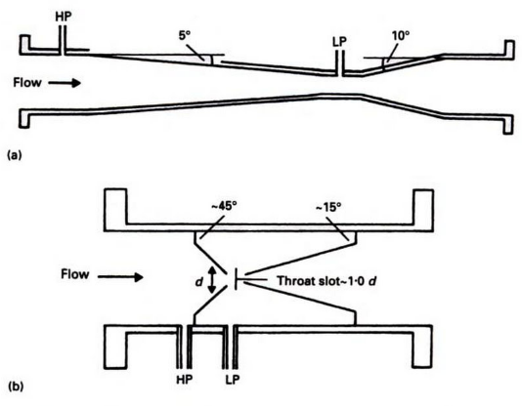
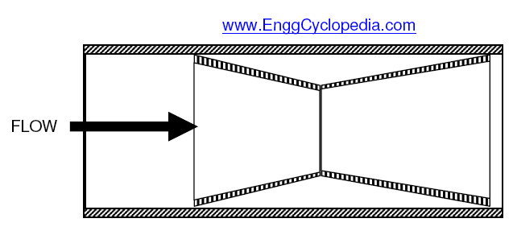
Dall Tube
a) Venturi
b) Dall tube

Slide 23
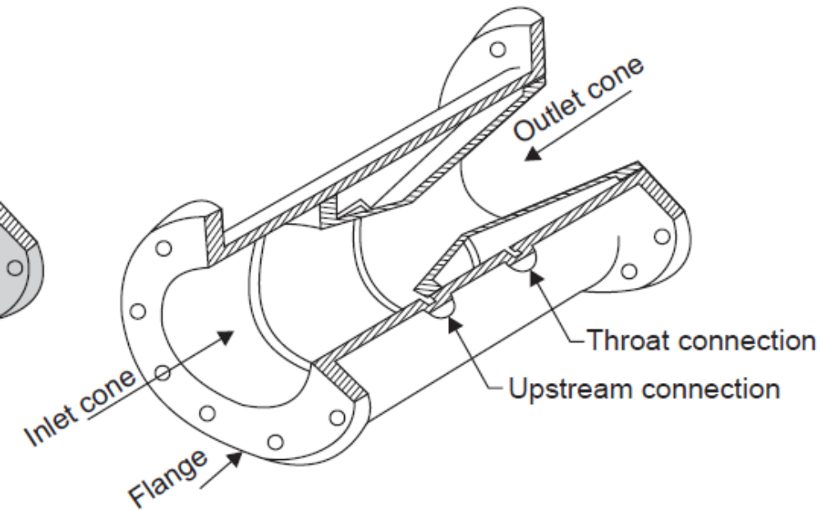

Slide 24
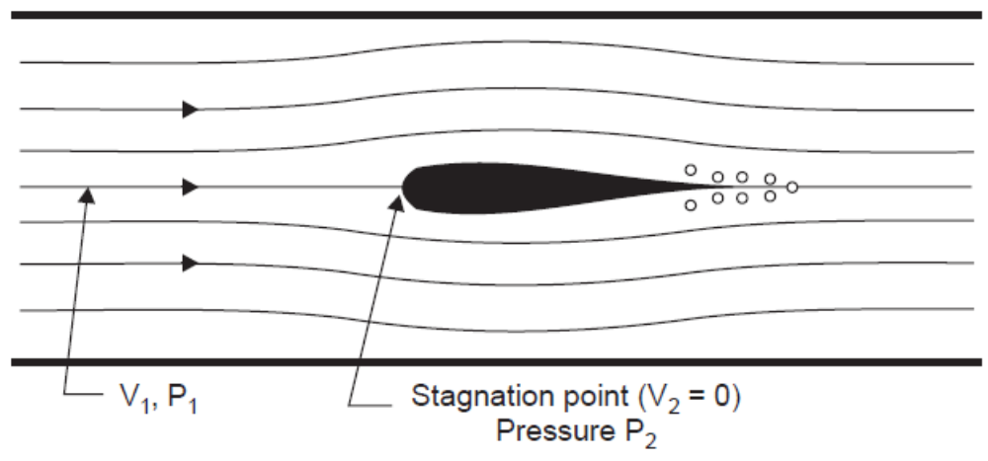
Pitot Tube

Slide 25
It is used mainly for fluid velocity measurement
the fluid while approaching the object starts losing its velocity till directly in front of the body
Where the velocity is zero, the point is known as the stagnation point
By measuring the difference of pressure between that at normal flow line and that at the stagnation point, the velocity is found out.

Slide 26
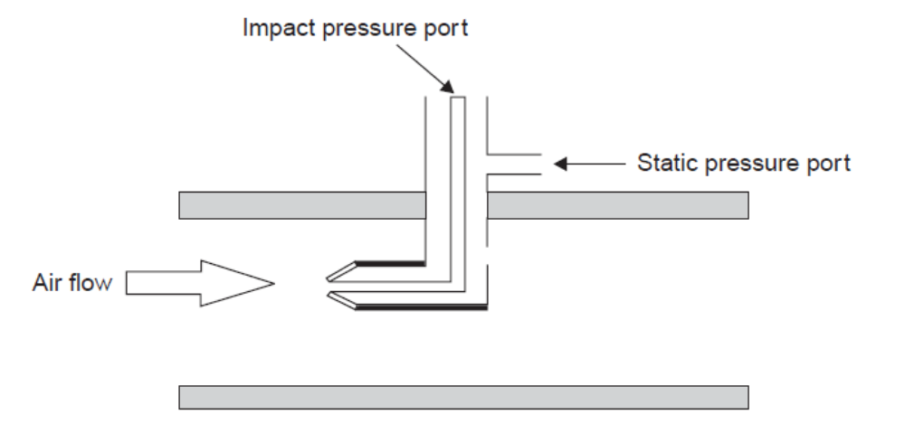

Slide 27
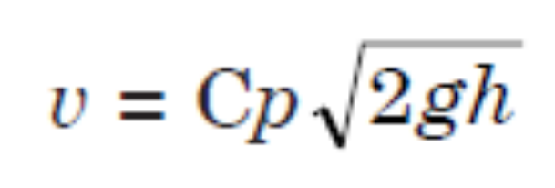
Velocity head is converted to impact pressure, which is sensed through a small hole in the upstream face of the probe.
The velocity equation for the pitot tube is given by
where Cp is the pitot tube constant

Slide 28
Advantages
1. No pressure loss.
2. It is relatively simple.
3. It is readily adapted for flow measurements made in very large pipes or ducts.
Disadvantages
1. Poor accuracy.
2. Not suitable for dirty or sticky fluids and fluids containing solid particles.
3. Sensitive to upstream disturbances.

Slide 29
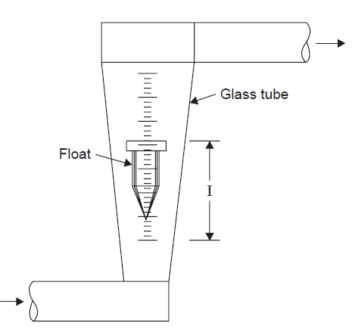
Rotameter

Slide 30
A weighted float contained in an upright tapered tube, is lifted to the position of equilibrium between the downward force of the plummet and the upward force of the fluid in addition to the buoyancy effect of the fluid
The metering tube is mounted vertically with the small end at the bottom.
The fluid to be measured enters at the bottom of the tube, passes upward around the float, and out at the top.
When there is no flow through the meter, the float rests at the bottom of the metering tube where the maximum diameter of the float is approximately the same as the bore of the tube.
Float reaches a stable position in the tube when the forces are in equilibrium.

Slide 31
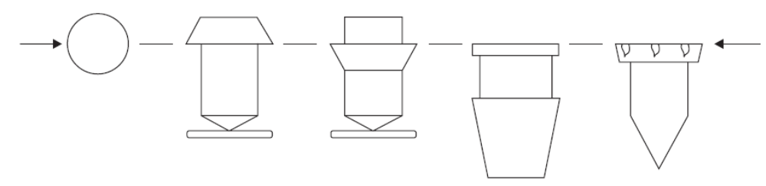

Slide 32
Advantages of Rotameter
1. Low cost.
2. Low pressure drop.
3. Rangeability is better.
4. It is suitable for small flow rates.
5. It is easily equipped with alarms and switches or any transmitting devices.
6. It also measures the flow rate of corrosive fluids.
7. There is an availability of viscosity-immune floats.
8. It can be used in some light slurry services.

Slide 33
Disadvantages of Rotameter
1. It is difficult to handle the glass tube type.
2. It must be mounted vertically.
3. It is not suitable for pulsating services.
4. Generally it is limited to small pipe services.
5. It is limited to low temperatures.
6. Accuracy is = ± 1/2 to 10%.
7. It requires in-line mounting.

Slide 34
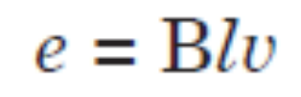
Electromagnetic Flow Meter
Electromagnetic flow meters use Faraday’s law of electromagnetic induction for making a flow measurement. Faraday’s law states that, whenever a conductor of length ‘l’ moves with a velocity ‘v’ perpendicular to a magnetic field ‘B’, an emf ‘e’ is induced in a mutually perpendicular direction which is given by
where B = Magnetic flux density (Wb/m2)
  l = length of conductor (m)
  v = Velocity of the conductor (m/s)

Slide 35
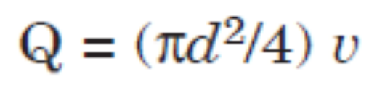
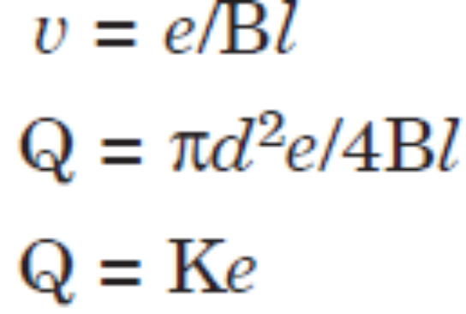
The volume flow rate Q is given by
where d = diameter of the pipe
v = average velocity of flow
where K is a meter constant.
Thus the emf generated is directly proportional to the velocity of flow.

Slide 36
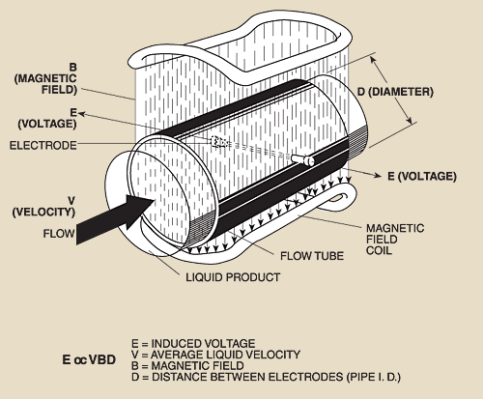

Slide 37
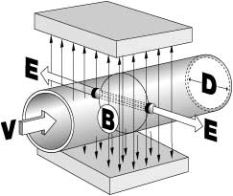

Slide 38
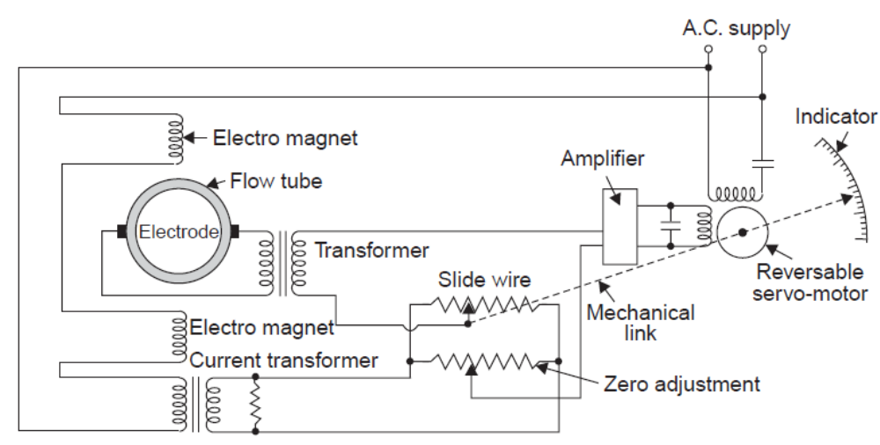

Slide 39
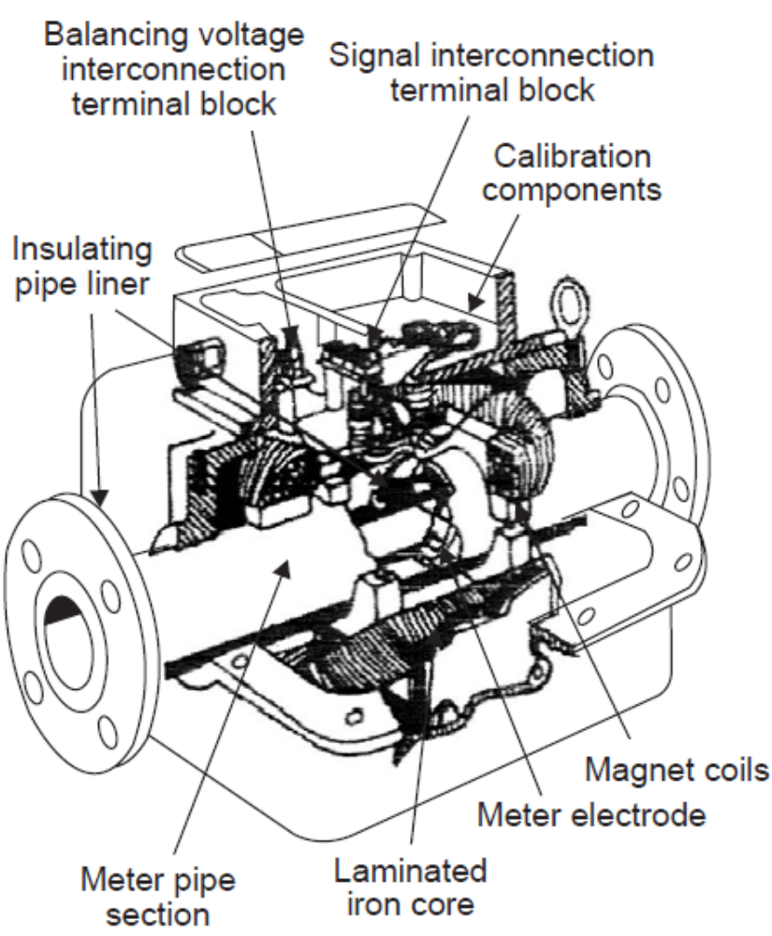

Slide 40
At alternating electric supply is used to energize electro magnet as a.c. supply avoids polarisation of the electrodes.
The basic elements of the flow meter is a section of non conducting pipe section such as glass-reinforced polyester
As the liquid passes through the pipe section, it also passes through the magnetic field setup by the magnet coils inducing a voltage in the liquid; the amplitude of the voltage is directly proportional to the liquid velocity.

Slide 41
Limitations of electromagnetic Flow Meters
The substance being measured must be conductive.
It is a very expensive device.
As a zero check on the installation can be performed only by stopping the flow
The pipe must run full, in case regulating valves are installed upstream of the meter

Slide 42
Advantages of EMFM
The obstruction to the flow is almost nil and therefore this type of meters can be used for measuring heavy suspensions, including mud, sewage and wood pulp.
There is no pressure head loss in this type of flow meter other than that of the length of straight pipe which the meter occupies
They are practically unaffected by variation in density, viscosity, pressure and temperature
Electric power requirements can be low (15 or 20 W), particularly with pulsed Dctypes
These meters can be used as bidirectional meters

Slide 43
Ultrasonic Flow Meters
Types of Ultrasonic Flow Meters
  (i) Transit time flow meters
  (ii) Doppler Flow meter.

Slide 44
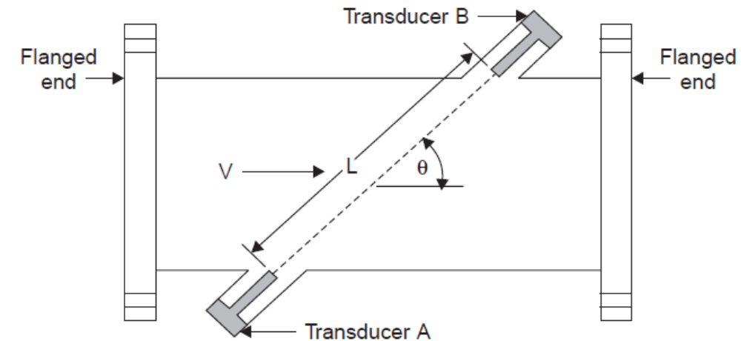
Transit Time Flow Meters

Slide 45
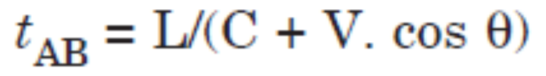
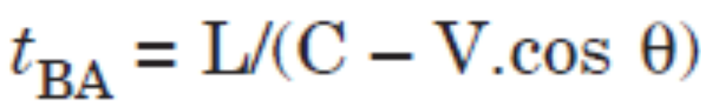
The time (t_{AB}) for the ultrasonic energy to go from transducer A to transducer B is given by the expression
The time (tBA) to go from B to A is given by
where C is the speed of sound in the fluid
L is the acoustic path length in the fluid
and θ is the angle of the path with respect to the pipe axis.

Slide 46
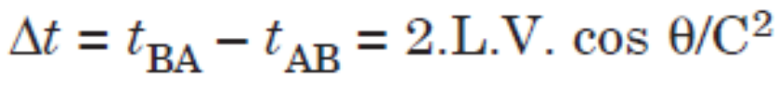
By combining and simplifying, it can be shown that for V << C :
the product of area and velocity will yield the volumetric flow rate.

Slide 47
Doppler Flow Meters
The transmitter of a Doppler flow meter projects an ultrasonic beam at a frequency of about 0.5 MHz into the flowing stream and deflects the reflected frequency.
The difference between transmitted and reflected velocities is called the ‘beat frequency’ and is related to the velocity of the reflecting surfaces (solid particles and gas bubbles) in the process stream.

Slide 48
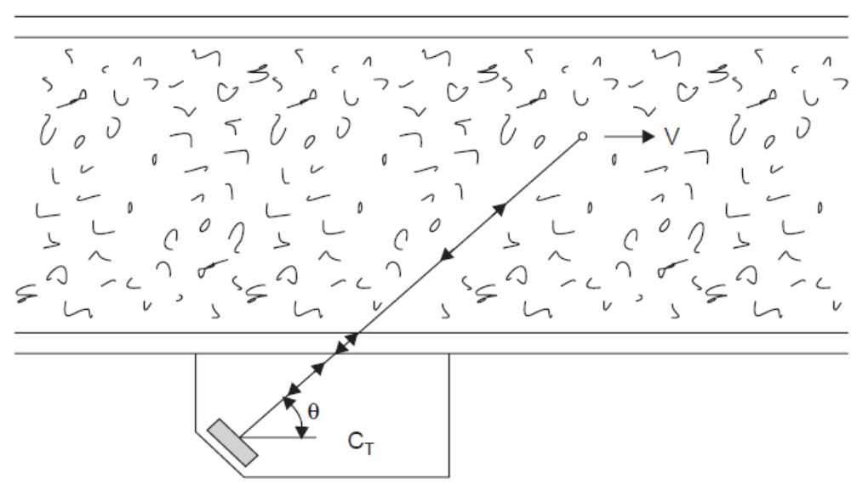
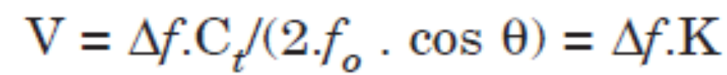
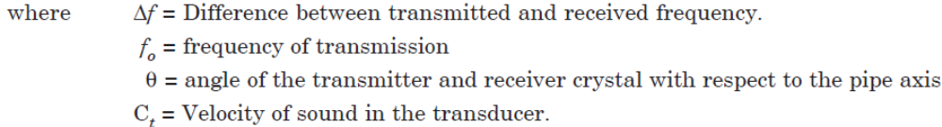

Slide 49
Anemometers
In hot wire anemometers, the filament is heated initially by means of passing an electric current. This heated resistive filament mounted on a tube is exposed to air flow or wind, which is cooled because of fanning effect. Depending on the velocity of air flow, the amount of cooling varies.

Slide 50
The resistance of the probe when it is hot is different from that when it is cooled.
This difference in resistance or this variation in resistance is converted into a voltage variation and thereby the flow velocity is converted into a voltage variation.

Slide 51
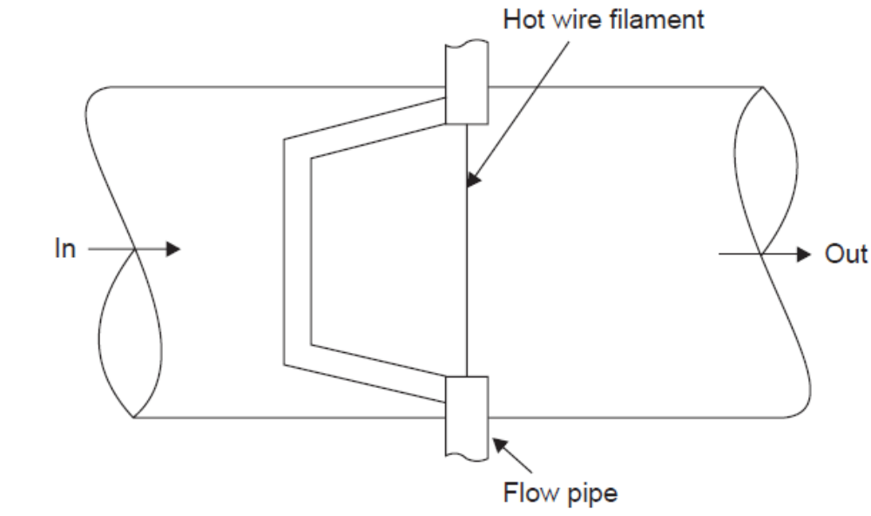

Slide 52
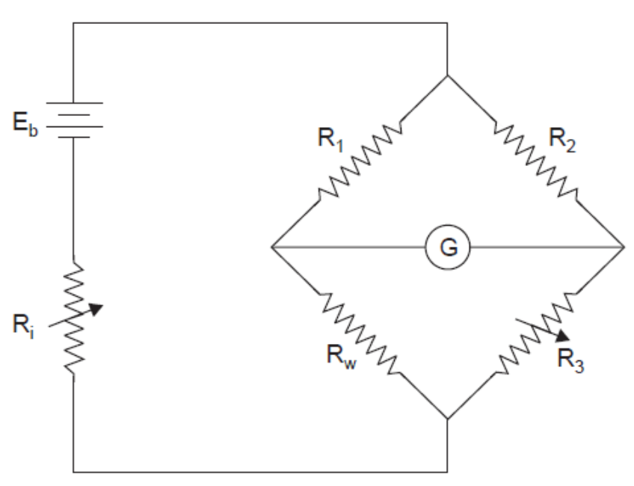
Hot wire anemometers are commonly available in two forms:
(i) Constant current type and
(ii) Constant temperature type.

Slide 53
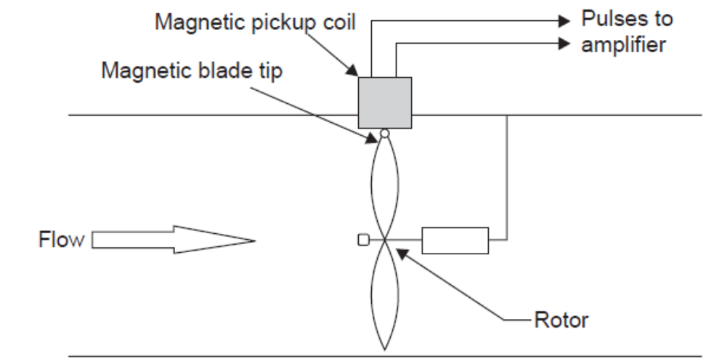
Turbine Flow Meters
The turbine flow meter is mainly used for the purpose of measurement of liquid and gas at very low flow rates.
The entire fluid to be measured enters the flow meter, then passes through a rotor.

Slide 54
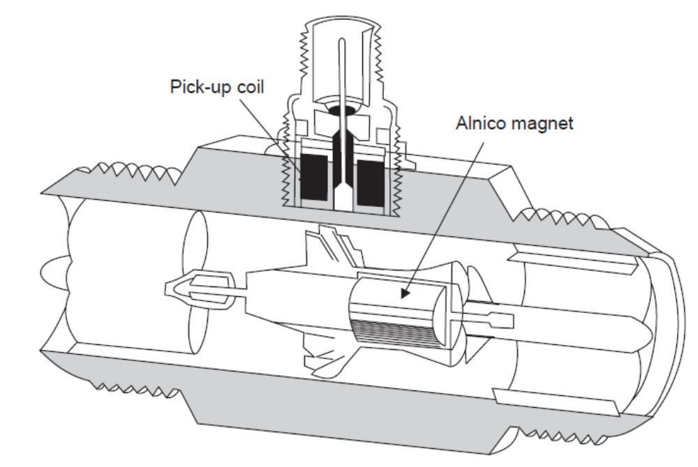

Slide 55
Advantages of TFM
1. Better Accuracy [± 0.25% to ± 0.5%].
2. It provides excellent repeatability [± 0.25% to ± 0.02%] and rangeability (10 : 1 and 20 : 1).
3. It has fairly low pressure drop.
4. It is easy to install and maintain.
5. It has good temperature and pressure ratings.
6. It can be compensated for viscosity variation.

Slide 56
Disadvantages of TFM
1. High cost.
2. It has limited use for slurry applications.
3. It is not suitable for non-lubricating fluids.
4. They cannot maintain its original calibration over a very long period and therefore periodical recalibration is necessary.
5. They are sensitive to changes in the viscosity of the liquid passing through the meters.
6. They are sensitive to flow disturbances.
7. Due to high bearing friction is possible in small meters, they are not preferred well for low flowrates.

Slide 57
Positive Displacement Meters
Positive displacement meters split the flow of liquids into separate known volumes based on the physical dimensions of the meter, and count them or totalize them.
Energy to drive these parts is extracted from the flow stream and shows up as pressure loss between the inlet and the outlet of the meter.
The general accuracy of these meters is dependent upon minimizing clearances between the moving and stationary parts and maximizing the length of the flowing path.

Slide 58
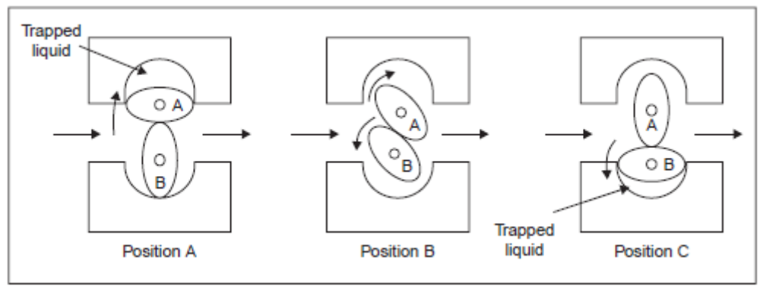
Oval—Gear Flow Meters (Positive displacement type)

Slide 59
OVAL-GEAR…
These oval-geared meters are generally used on very viscous liquid, which is difficult to measure using other flow meters
If slippage between the oval-gears and the housing is small, and the flow rate and viscosity are high, these flow meters can provide high accuracies. (0.1%)
These flow meters are available in the sizes suitable for 6 mm to 400 mm diameters pipelines
Their materials of construction include brass, carbon steel, and 316 stainless steel
Operating pressures are available up to 100 kg/cm2 and temperatures up to 300°C

Slide 60
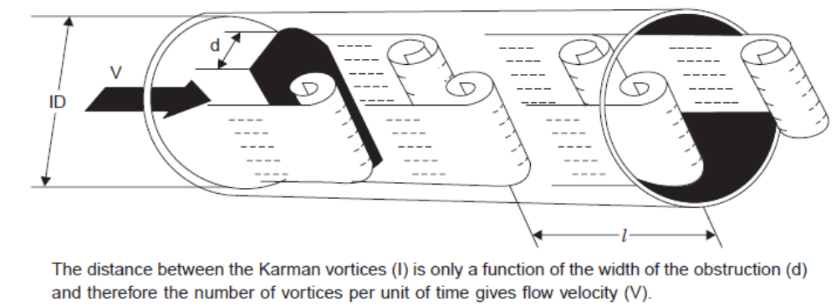
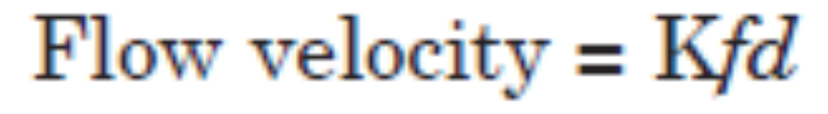
Vortex Flow Meter

Slide 61
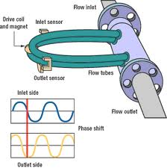
Coriolis flow meter

